Slide 1

HARMONY
Project Guide
Prof. Rajashri Chaudhari
Rohan Waghode 21107008
Sumit Samanta 21107003
Harsh Shelke 21107022
Sonal Sonarghare 21107033

Slide 2
Contents
Introduction
Objectives
Features
Built in functions used
Block Diagram
Output Screenshots

Slide 3
1. Introduction
MUSIC PLAYER:
“Where words fall, music speaks”
The primary purpose of the music streaming application is to play and show music available in the databases of the service.
Music players allow one to enjoy music in any browser and supports a lot of the features of an offline music player.

Slide 4
2. Objectives
To build a user friendly platform for playing music of different genre.
To achieve smooth flow and more support from the user
To create an atmosphere of music
To make easier to let user find their favourite artists/songs.
To build experience of modern music .

Slide 5
4. Features:
Signing Up/Registration
It is an essential feature that recognizes the user to sync his music and
playlist in the service.
Catalog
A music catalog to assist the user in finding music content of the application.
Artist & Album Profiles
It is optional to add an artist and album. To let the user, get details of the track they are tuned to.
Music Player
You must ensure that you embrace such features to craft timing, shuffling, and tuning options for your app’s music player.

Slide 6
7. Block Diagram/ Flow diagram
MUSIC PLAYER
SIGN IN/
REGISTER
GENRE
CATALOG
ARTISTS
SONG IMAGE
PLAYER
MUSIC CONTROLLING
PLAY/PAUSE

Slide 7
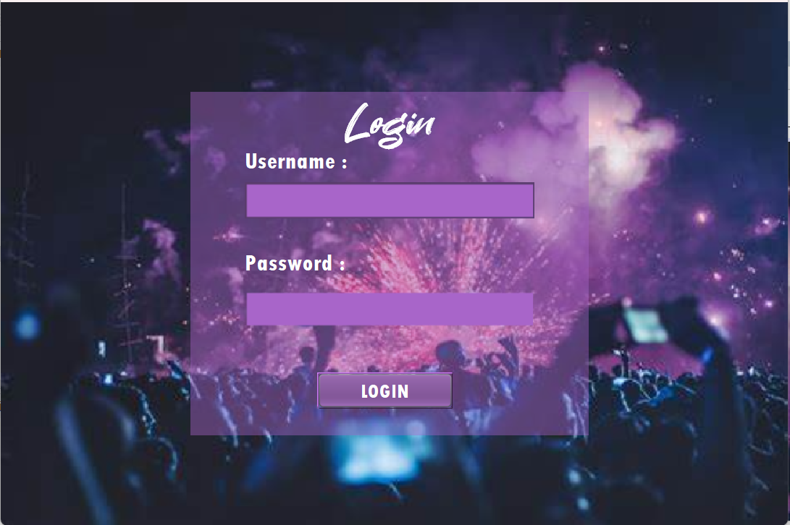
5. Output of Project

Slide 8
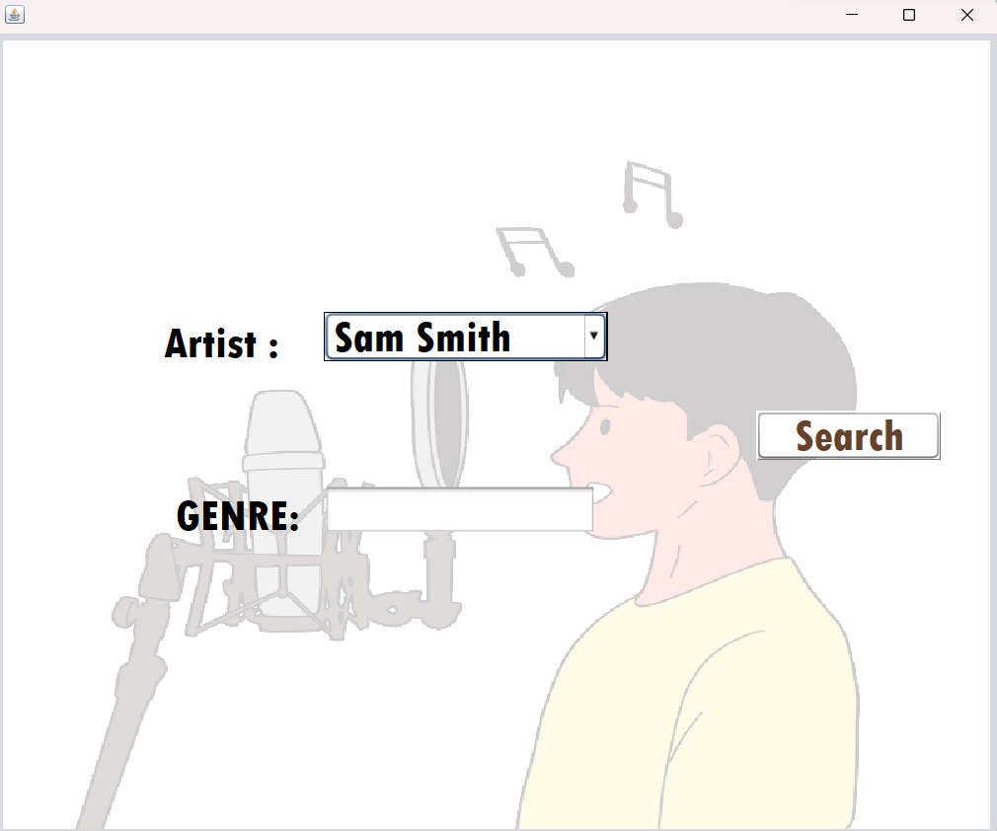
5. Output of Project

Slide 9
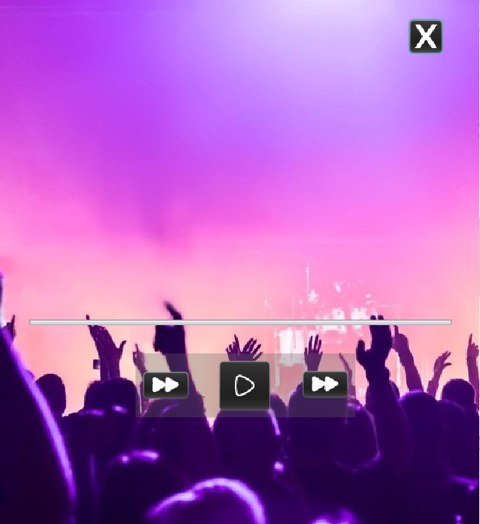
5. Output of Project

Slide 10
Thank You...!!

